Slide 1
Semantic HTML5 Tags
Making the most of the new tags

Slide 2
How to Design
The most important step in web design is the design.
You need a clear picture of what you want to create, before you can begin coding.

Slide 3
How to Design
<header>
<section>
<aside>
<article>
<footer>

Slide 4
Using Semantic Tags
In the beginning (insert dramatic music of your choice…) there was div
<div> was a way to group related content together
Divs almost always had special classes/ids associated with them
<div class = “header”>…</div>
<div class = “section”>…</div>
<div class = “footer”>…</div>

Slide 5
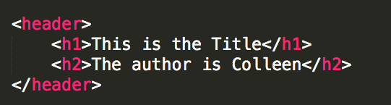
<header>
A group of introductory or navigational aids: title, navigation links, etc.
Not to be confused with <head> or the different headings.

Slide 6
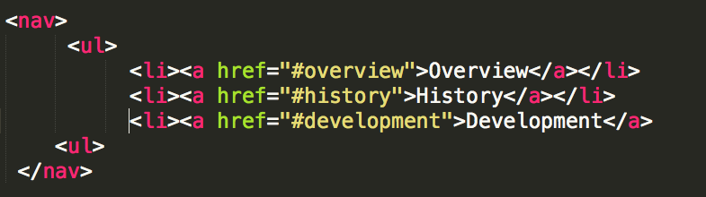
<nav>
A section of the page that links to other pages or to parts within the page.
Often found in the <header> tag

Slide 7
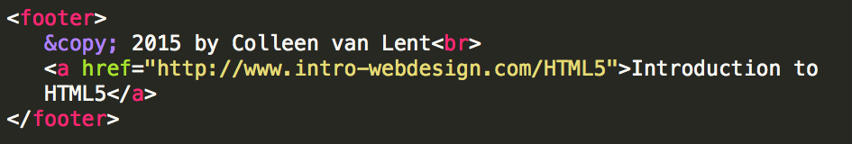
<footer>
A section that contains info such as copyright data, related documents, and links to social media
Typically at the bottom of the page, but not required.

Slide 8
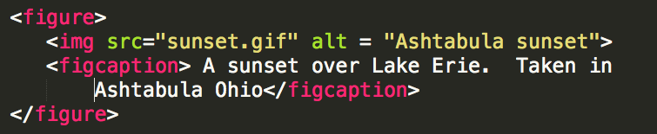
<figure>
More semantics than <img>. Can include:
caption
multiple multi-media resources

Slide 9
Other New Tags
Structural Elements
article, aside, main, menuitem, summary, section
Form Elements
datalist, keygen, output
Input Types
color, date, email, list
Graphics Elements
canvas, svg
Media Elements
audio, embed, source, track, video

Slide 10
Review
The age of <div> is ending
Semantic tags help guide users to information in your page

Slide 11

Acknowledgements/Contributions
These slides are Copyright 2015- Colleen van Lent as part of http://www.intro-webdesign.com/ and made available under a Creative Commons Attribution-NonCommercial 4.0 License. Please maintain this last slide in all copies of the document to comply with the attribution requirements of the license. If you make a change, feel free to add your name and organization to the list of contributors on this page as you republish the materials.
Initial Development: Colleen van Lent , University of Michigan School of Information

